Slide 1
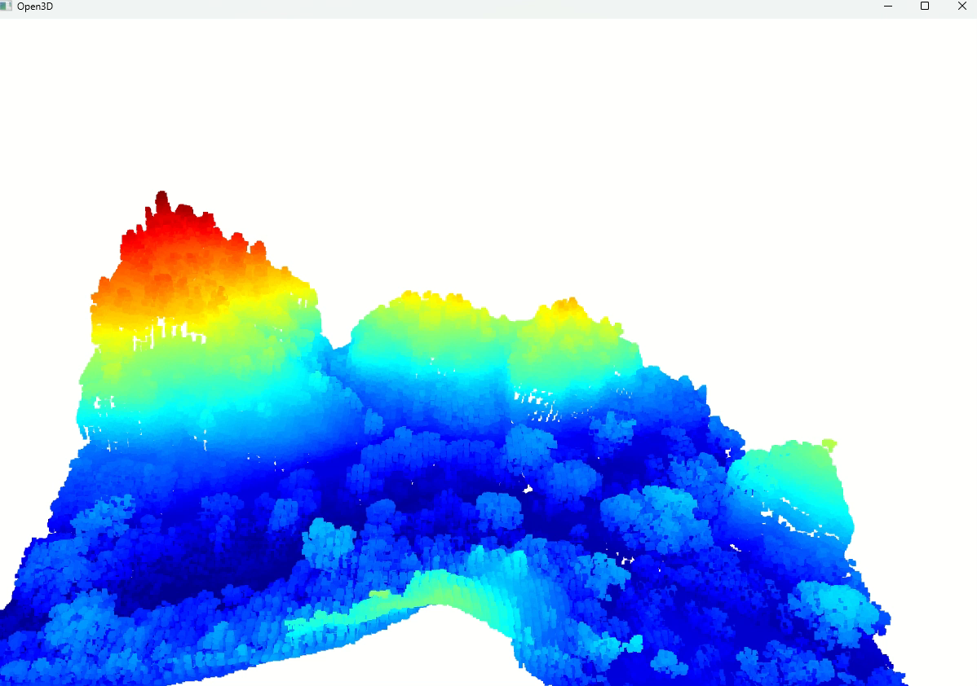
Seeing the Unseen: How LiDAR unlocks hidden Landscapes
Many geospatial companies rely on Light Detection and Ranging (LiDAR) to generate high-resolution, three-dimensional models of the Earth's surface, terrain, and manmade structures.
LiDAR Point Cloud data is widely used in Geospatial and Earth observation applications. LiDAR is a remote sensing technique that uses light from a laser to measure out the Elevation like buildings, ground, and forest like this LiDAR image.
LiDAR gives an accurate 3D representation of Earth's surface. It allows us to examine natural and artificial features with accuracy and precision.
LiDAR along with other Geospatial tools are part of the toolkit used by GIS researchers and analysts.
Sources and Tools used:
Base code is Python and Jupyter Notebook as IDE.
Data - https://opentopography.org/
To visualize the data: Open3D - https://pypi.org/project/open3d/
Laspy pypi - https://pypi.org/project/laspy/
Lidar point classification -
https://desktop.arcgis.com/en/arcmap/latest/manage-data/las-dataset/lidar-point-classification.htm
Numpy stack - https://numpy.org/doc/stable/reference/generated/numpy.stack.html
Numpy transpose - https://numpy.org/doc/stable/reference/generated/numpy.transpose.html

Slide 2
"""
Visualizing LiDAR Data – Code written in PYTHON
"""
#%%
# Import packages: You may need to use:
# pip install numpy
# pip install laspy
# pip install open3d
import numpy as np # Laspy is a python library for reading, modifying and creating LAS LiDAR files.
import laspy # Open3D is an open-source library that supports rapid development of software that deals with 3D data
import open3d as o3d # NumPy is the fundamental package for scientific computing in Python.
#%%
# Use laspy.read() to read Lidar Data. Use laspy.open() if you want the metadata only.
# las header for the data looks like:
# <LasData(1.1, point fmt: <PointFormat(1, 0 bytes of extra dims)>, 277573 points, 1 vlrs)>
# contains: las header, the point format, point count and vlrs
# To get separate outputs for each one
# las.header
# las.header.point_format
# las.header.point_count
# las.vlrs
las = laspy.read('lidar/las_data/points.las')
#%%
# Can look at available features for the lidar file by using list()
list(las.point_format.dimension_names)
#%%
set(list(las.classification))
#%%
set(list(las.classification))
#%%
# Creating, Filtering, and Writing Point Cloud Data
# To create 3D point cloud data, we can stack together with the X, Y, and Z dimensions, using Numpy like this.
point_data = np.stack([las.X, las.Y, las.Z], axis=0).transpose((1, 0))
#%%
# 3D Point Cloud Visualization
# Laspy has no visualization methods so that we will use the "open3d" library. We first create the open3d geometries and pass the point data we have created earlier. Finally, we use the open3d visualization to draw geometries.
geom = o3d.geometry.PointCloud()
geom.points = o3d.utility.Vector3dVector(point_data)
o3d.visualization.draw_geometries([geom])
# open3d opens a window, showing the Lidar image of a Forest in U.S.

